Slide 1

SLIDE 1
TECHNOLOGY CRAZY
2. SAKTHI S M
Ph no: 7548827598
3. INTERNET OF THINGS (IOT) - Smart Sensor Racquet
4. When playing tennis, we need skills. If we detect the skill which we are specialist helps to get successful in matches.

Slide 2
SLIDE 2
In Tennis , if we want to become a talented in this field. We have to keep on trying different methods for playing the game well. But the major problem is to detect the velocity at which we can use racquet to get maximum score. So, Sensor can be used to detect the
Acceleration ,
Velocity and
Angles.

Slide 3
SLIDE 3
INERTIAL MEASUREMENT UNIT (IMU) SENSORS
Sensor(IMU) can be placed on sporting equipment to record information such as, velocities, accelerations and angles, that can be tracked and programmed.
The racquet is meant to improve performance by letting a player or coach set specific goals and chart progress using graphic profiles and data analysis provided by the app and online service.
Information like the number of shots hit, however accuracy tends to be upheld when it comes to recording speed.
Sensor make easy to build a Perfect player in this field.

Slide 4
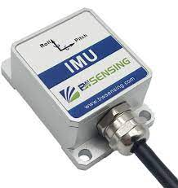
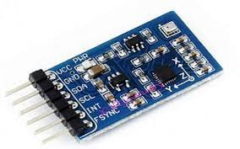
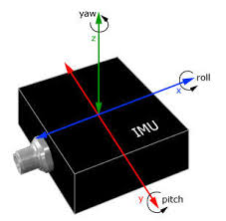
SLIDE 4
INERTIAL MEASUREMENT UNIT (IMU) SENSORS

Slide 5
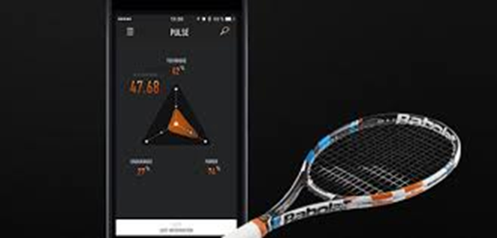
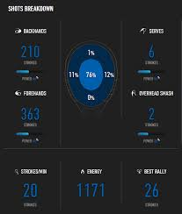
SLIDE 5
SOFTWARE IMPLEMENTATION

Slide 6
SLIDE 6
USECASE:
To make a best player in India.
Cost less for sensing talent.
Eco friendly.

